Slide 1
Sense-Hat Controlled Pictionary Game
ELE 408
Nicholas Clavette
Johann Karl Muller

Slide 2
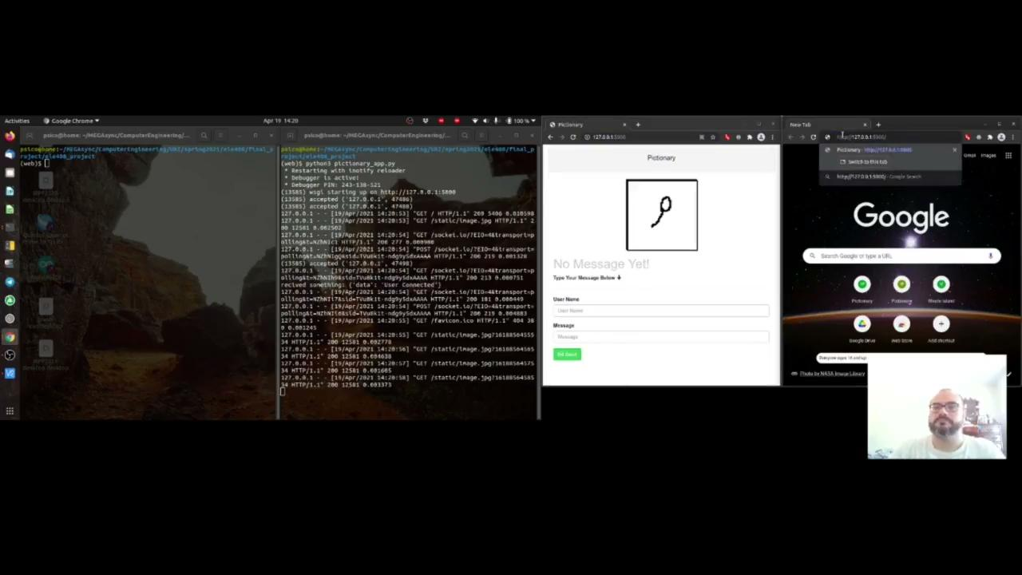
Project Demonstration

Slide 3
Project Summary
Drawing with the gyroscope data is really hard, but has the potential to be really fun
Better algorithms for motion tracking are needed, and this project is a good platform to test future algorithms on
A more accurate IMU than the one on the Sense Hat would improve calibration performance

Slide 4
Thank you

